Slide 1
W_{h}eRe
Future app for picking up your own place to live

Slide 2






Our team

Slide 3


Goal:
To find most suitable places to live work and have fun in your new location.
2 general use cases

Slide 4
Use case 1
Looking for a flat/home
New comers
Tourists
Students, Expats
+ kindergarden
+ supermarket
+ pricing
+ church
- clubs
- highway

Slide 5
Use case 2
Want to start new business/restaurant
Interpreneurs
Real estate agents
+ other restaurants (poor rating )
+ stable occupancy index / time period
- Other restaurants (good rating)
- low occupancy index / time period = city deserts

Slide 6
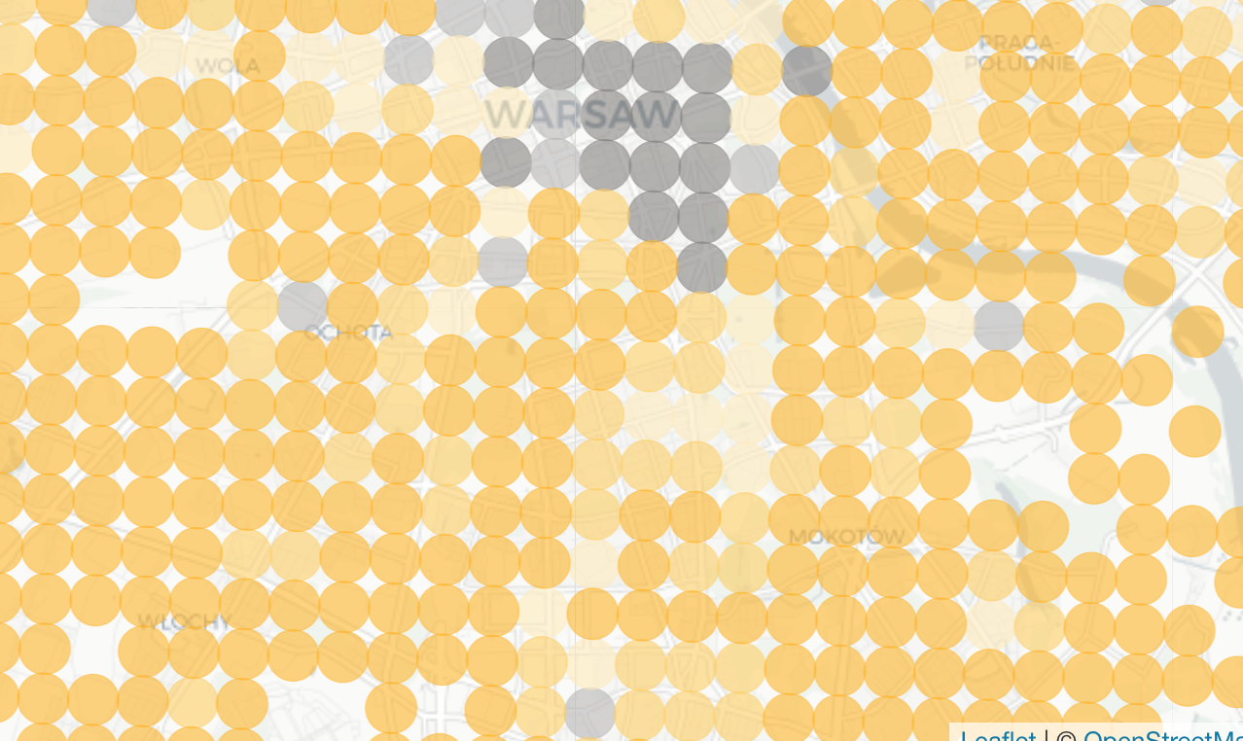
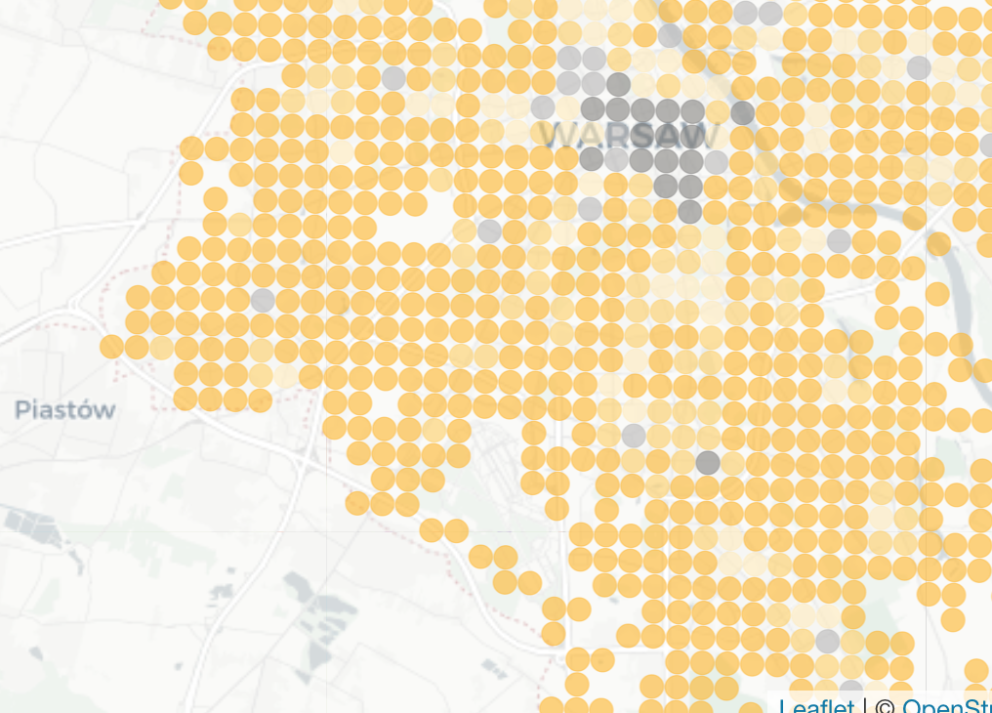
Functionality

Slide 7
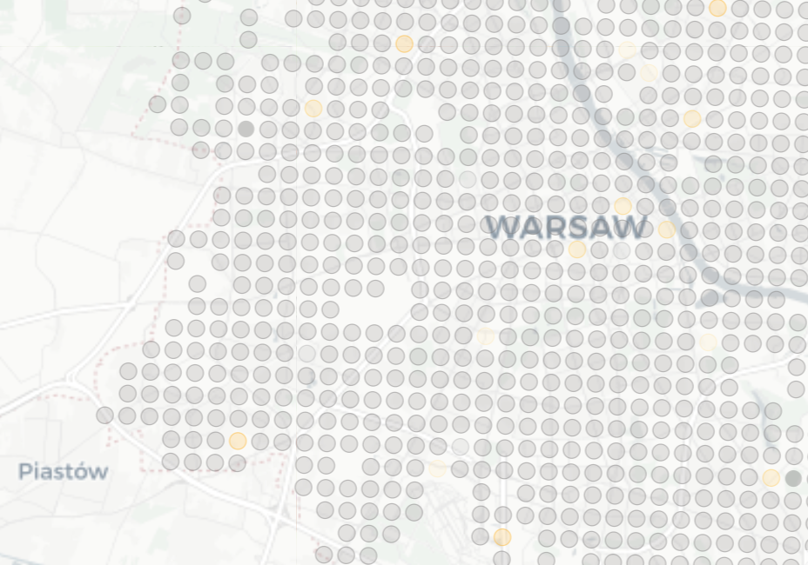
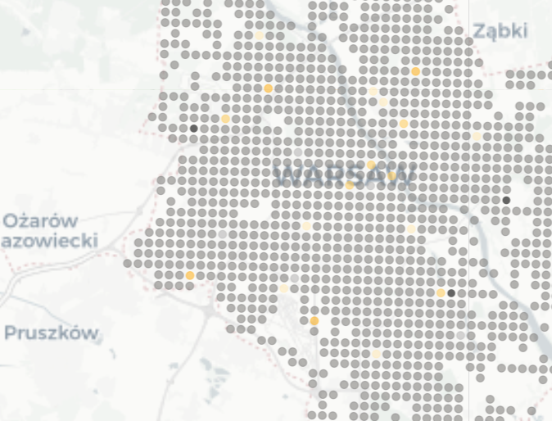
Functionality

Slide 8








Categories / scoring
+++
+
---
-

Slide 9
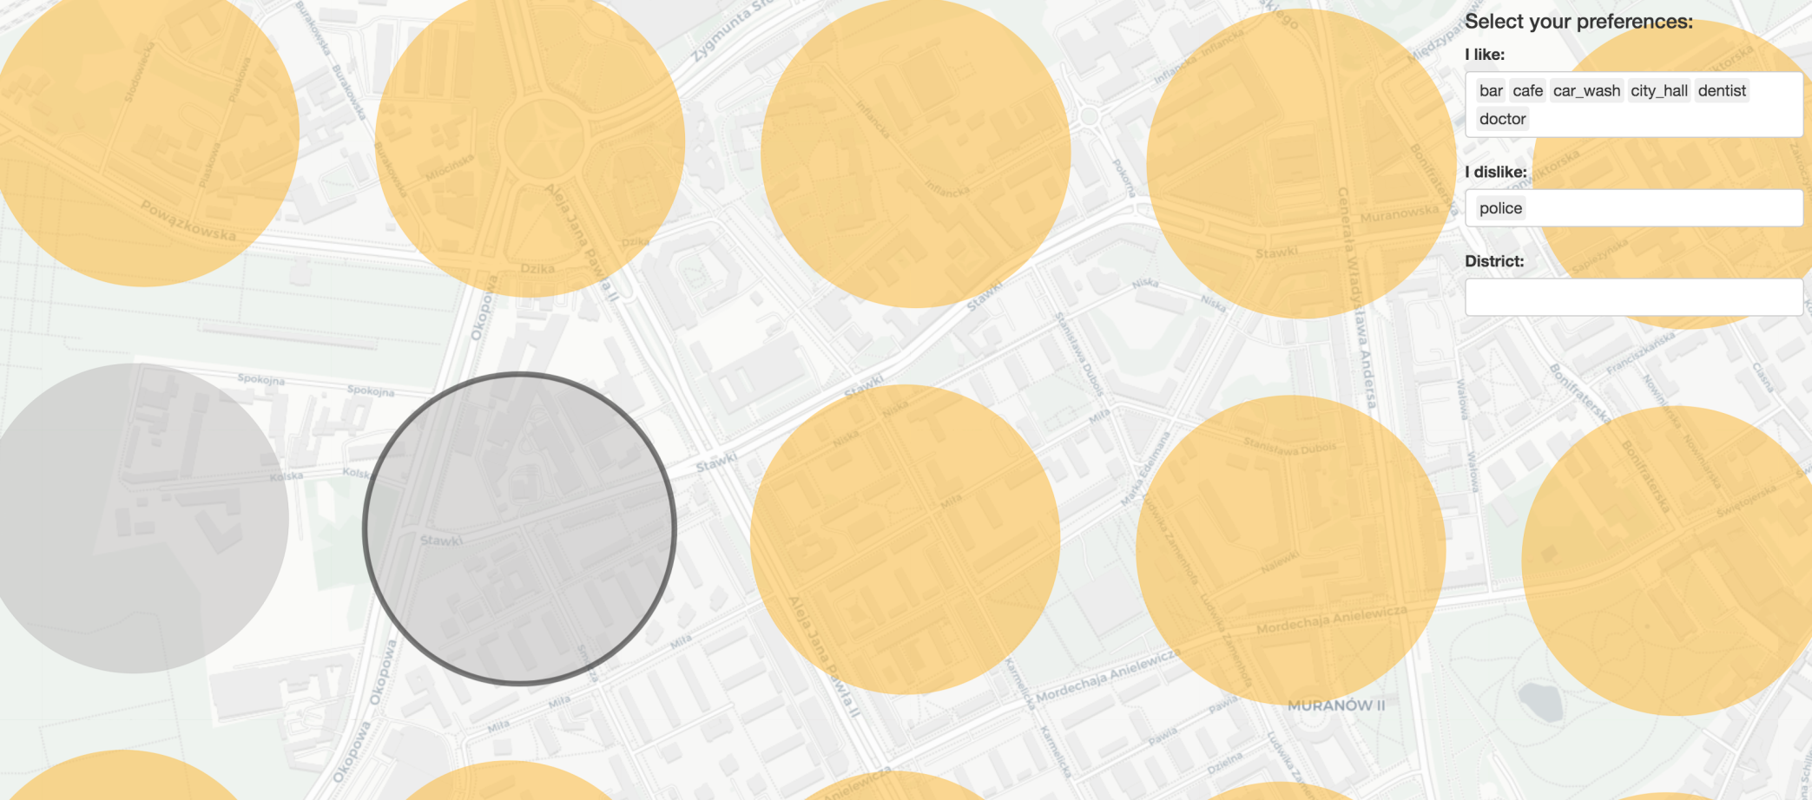
Case study – Stawki

Slide 10
Categories

Slide 11
W_{h}eRe
helps you where you want to be

